Slide 1
  Factory Pattern: The Factory Medhod
Zafer Güler

Slide 2

The Factory Pattern
The Factory Medhod
Demo (Screen Factory)
Questions

Slide 3

Also known as Simple Factory Pattern.
  Simple Factory pattern returns an instance of one of several possible classes depending on the data provided to it.
  Usually all classes that is returns have a common parent class, but each performs a different task.
  The Factory Pattern serves as an introduction to the Factory Method Pattern

Slide 4

A simple factory pattern
X
(from default)
(local to package)
Xfactory
(from default)
+Xfactory()
+getClass(int):X
X
+do_X
XY
(from default)
XZ
(from default)
Produces different instance of X depending on value of argument
+XY
+do_X
+XZ
+do_Z

Slide 5

Suppose we have an entry form
User can enter his name either “firstname lastname” or “lastname, firstname”
We will decide the name order by whether there is a comma between last and first name.
Start by defining a simple base class that take a String and split it.

Slide 6

public class Namer {
//base class extended by two child classes
protected String last; //split name
protected String first; //stored here
public String getFirst() {
return first; //return first name
}
public String getLast() {
return last; //return last name
}
}
In this base class, we don't compute any names but we do provide implementations of the getFirst and getLast methods.

Slide 7

Write two simple subclasses that split name into two parts.
public class FirstFirst extends Namer {
//extracts first name from last name when separated by a space
public FirstFirst(String s) {
int i = s.lastIndexOf(" "); //find sep space
if (i > 0) {
first = s.substring(0, i).trim();
last = s.substring(i + 1).trim();
} else {
first = ""; // if no space
last = s; // put all in last name
}
}
}

Slide 8

public class LastFirst extends Namer {
//extracts last name from first name when separated by a comma
public LastFirst(String s) {
int i = s.lastIndexOf(" ,"); //find comma
if (i > 0) {
last = s.substring(0, i).trim();
first = s.substring(i + 1).trim();
} else {
last = s; // if no comma
frist = “”; // put all in first name
}
}
}

Slide 9

Our Simple Factory class extremely simple
public class NamerFactory {
//Factory decides which class to return based on presence of a comma
public Namer getNamer(String entry) {
int i = entry.indexOf(","); //comma determines name order
if (i > 0)
return new LastFirst(entry);
else
return new FirstFirst(entry);
}
}

Slide 10

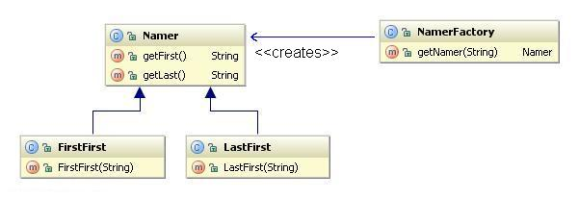

Slide 11

Factory Patterns are examples of creation pattern.
Creates or manufactures objects, just like a real factory.
The factory Method pattern defines an interface for creating an object, but let subclases decide which class to instantiate. Factory Method lets a class defer instantiation to subclasses.
Class creational patterns focus on the use of inheritance to decide the object to be instantiated.
  Factory Medhod

Slide 12

Application class is responsible for creation (and management) of Documents.
Document
Application
Open()
docs
Document* doc = CreateDocument();
Save()
CreateDocument()
docs.Add(doc);
Close()
NewDocument()
doc->Open();
Revert()
OpenDocument()
MyApplication
MyDocument
CreateDocument()
return new MyDocument
creates

Slide 13

Problem
  Application class knows: When a new document should be created.
  Application class does’nt know: What kind of document to create.
Solution
  Application classes redefine abstract CreateDocument () method to return an appropriate Document subclass instance.

Slide 14

Use the Factory Method pattern when
  A class can't anticipate the class of objects it must create.
  a class wants its subclasses to specify the objects it creates.
  classes delegate responsibility to one of several helper subclasses, and you want to localize the knowledge of which helper subclass is the delegate.

Slide 15

Product (Document)
  Defines the interface for the type of objects the factory method creates.
ConcreateProduct (MyDocument)
  implements the Product interface.
Creator (Application)
  Declares the factory method, which returns an object of type Product
ConcreateCreator (MyApplication)
  overrides the factory method to return an instance of a ConcreteProduct.

Slide 16

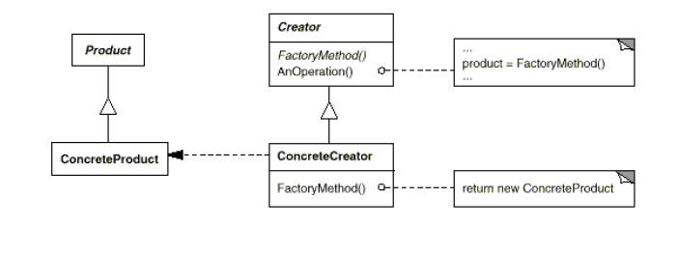
Collaborations
  The Abstract Class relies on its subclasses to define the factory method so that it returns an instance of the appropriate Concrete Product

Slide 17

Best to use when there is a default way of creating objects.
Easy to use, flexible - easy to define new subclasses of AbstractClass.
Genericity - no need to bind specific classes into frameworks; framework only deals with the interface of AbstractProduct.

Slide 18

May result in a large set of subclasses of AbstractClass, none of which does very much. Two- class hierarchies must evolve simultaneously.
Defining a new subclass could result in many changes if not done correctly (i.e., ConcreteClasses should be instantiated at a single point

Slide 19

Two major varieties.
  The case when the Creator class is an abstract class and does not provide an implementation for the factory method it declares
  The case when the Creator is a concrete class and provides a default implementation for the factory method (Simple Factory Pattern).
Demo (Screen Factory).

Slide 20

Thanks.

Slide 21

Design Patterns - Elements of Reusable Object-Oriented Software, Gang of Four (Gamma, Helm, Johnson, Vissides) ISBN:0201633612
Java Design Patterns - A Tutorial. James W. Cooper ISBN: 0201485397
Design Patterns Explained, Alan Shalloway and James R. Trott, Addison-Wesley, 2001
Head First Design Patterns, Freeman and Freeman, O'Reilly, 2004
http://userpages.umbc.edu/~tarr/dp/lectures/Factory-2pp.pdf
http://sourcemaking.com/design_patterns/factory_method

